Slide 1



Dictionary
With Suggestions
Shubham Thakar 2019130065
Ashish Todi 2019130066
Vedanth Raja 2019130069

Slide 2

Problem Statement
  Implementing a dictionary using trie data structure.
  When the user enters a word as input, meaning of the word will be displayed.
  Dictionary is prebuilt using a dataset of ~500 words.

Slide 3
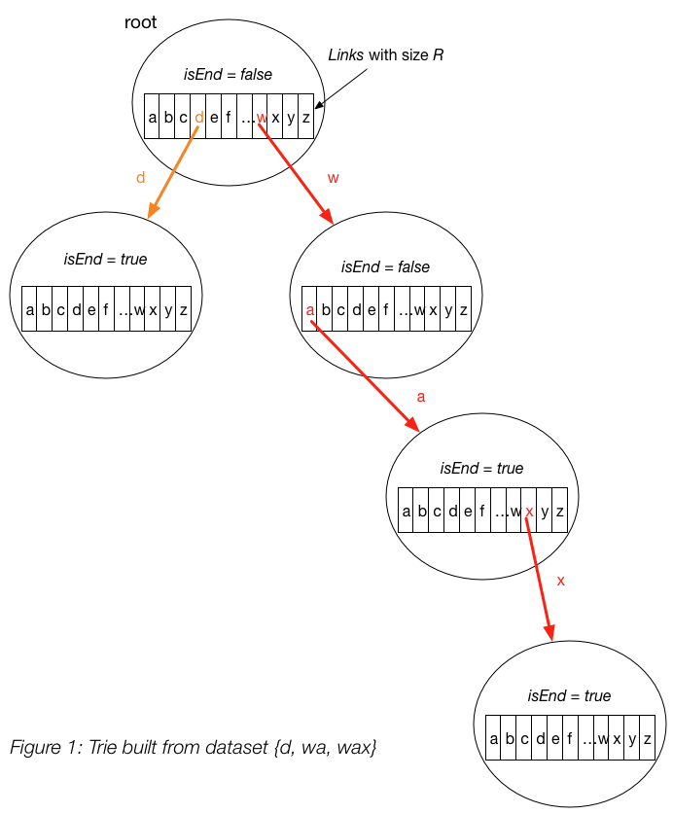
Data Structure
Tries
  A trie is a tree-like data structure. By structuring the nodes in a particular way, words and strings can be retrieved from the structure by traversing down a branch path of the tree.
  Every node of Trie consists of multiple branches.

Slide 4

Tries vs Hash Maps
The hash tables can only find in a dictionary, words that match exactly with the single word that we are finding.
Whereas the trie allows us to find words that have a some characters different, a prefix in common, a character missing, etc.
Since we wanted to provide the user with word suggestions if he enters a wrong word, we chose tries over hash tables.

Slide 5

Implementation
  The dataset is present in the form of a CSV file. It is imported using the Pandas framework and inserted into the Trie.
  We have implemented insert, search and autocomplete operations on the Trie data structure.

Slide 6
INSERT
Insert function is used to initially build the dictionary by storing the words in the Trie. It is called at the start of the program.
SEARCH
This function is called whenever the user clicks on the search button. The trie is traversed downwards from the root according to the letters in the search word. If the node reached at the last letter of the word has isEndOfWord true, search function returns the meaning of word.
AUTOCOMPLETE
If the search function results in an unsuccessful search, the autocomplete function is called. In the autocomplete function we will display the words which have common letters to the original and ask user to search for them.

Slide 7
Implementation
  The GUI has been implemented using the Tkinter package.
  The main window takes input of search word and provides buttons to search and exit.
  The output opens in a new window.

Slide 8

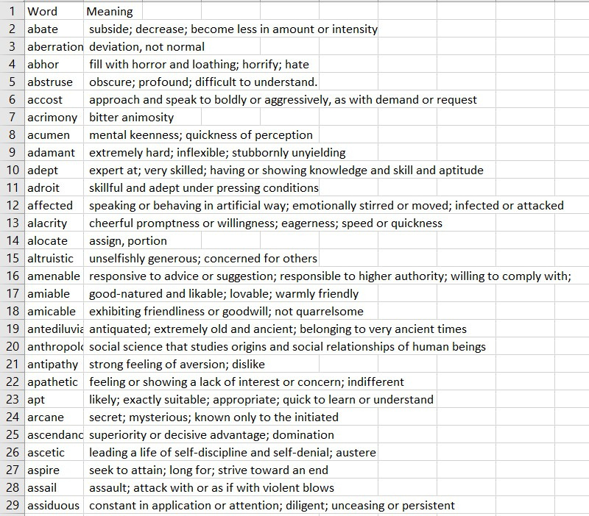
Dataset at a glance

Slide 9
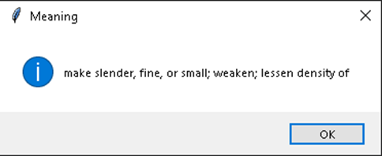
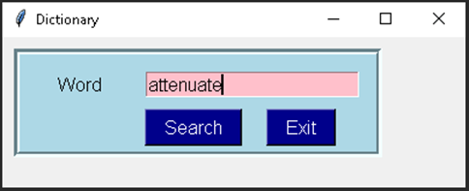
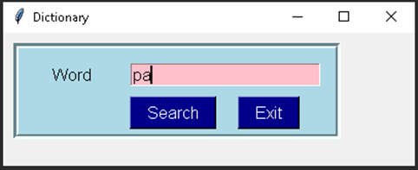
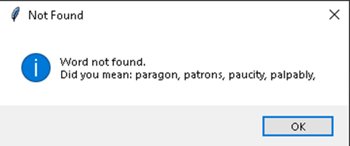
Output

